Slide 1
Flat Stanley’s Trip to New York!
Brittany Colavito
Lindsay Spinner
Grace Morgan
Beth-Michelle Jones
Colleen Donovan

Slide 2
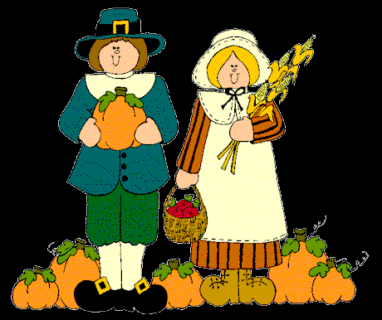
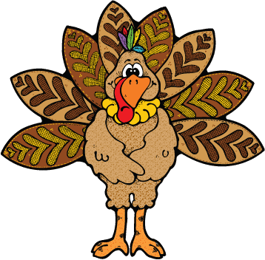
Thanksgiving!
Thanksgiving is a tradition that started a very long time ago when people called
Pilgrims
came to America! Now, people celebrate Thanksgiving by eating a lot of Turkey
and being thankful what we have!

Slide 3
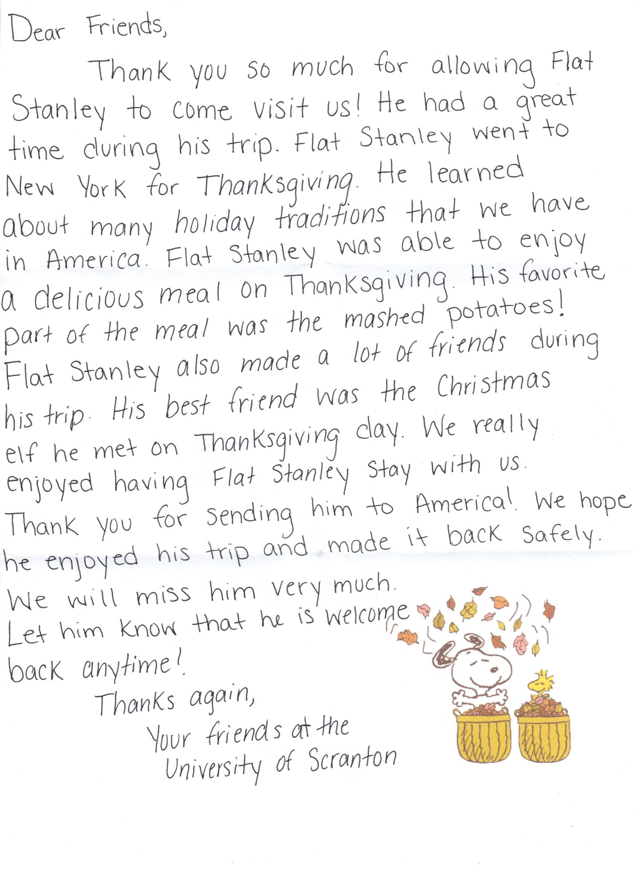

Slide 4
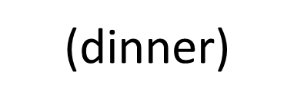
Flat Stanley waiting to eat his Thanksgiving dinner!
저녁 식사

Slide 5
Flat Stanley next to his Nativity calendar! (There’s chocolate in there!)
캘린더
(calendar)

Slide 6
Flat Stanley hanging out with our Christmas elf! She comes to visit us after every Thanksgiving and leaves on Christmas Eve!
크리스마스
(Christmas)

Slide 7
Flat Stanley is hanging out with his friend the turkey and the pilgrims!
친구
(friends)

Slide 8
Flat Stanley finally got his Thanksgiving dinner! There’s turkey, stuffing, mashed potatoes, turnips, green beans and peppers!
저녁 식사
(dinner)

Slide 9
Flat Stanley’s first time home for the holidays!
집(home)

Slide 10
Flat Stanley’s first time playing in the fall leaves!
잎 (leaf)

Slide 11
Flat Stanley is so tired after running a mile on Thanksgiving morning!
실행할 (run)

Slide 12
Flat Stanley is ready to dig in!
음식
(food)

Slide 13
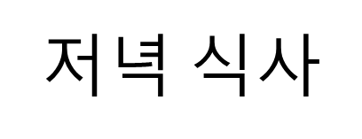
Flat Stanley is on his way to Thanksgiving dinner!
(dinner)

